Slide 1
Critical Materials for the Clean Energy Transition
Iowa Energy Panel
Thomas Lograsso
November 8, 2022
Notes:
Once again welcome to the Annual Meeting.
CMI is DOE’s Energy Innovation Hub with a mission to accelerate innovative scientific and technological solutions to develop resilient and secure supply chains for rare-earth metals and other materials critical to the success of clean energy technologies. CMI has begun its 9th year of operation as a public-private consortium, led by the Ames Laboratory along with 3 other national labs, 12 Universities and 27 private sector team members.
In this opening talk, I will describe how our transformative early-stage R&D has impacted supply chains in both the permanent magnet and Li-ion Battery market segments. I hope to show you how the research and innovations we work on are being matured and scaled through our private sector partners to deploy technology in the field and on the factory floor. Following my introduction, we will have three invited presentations focused on DOE new initiatives earth shot, a presentation on efforts by our neighbor Canada on their programming around critical minerals and our last plenary on the efforts of our sister energy innovation hub, the joint center for energy storage research. Later today each of our focus areas will present their activities providing an overview of their FA objectives, achievements for the past year and plans for the future.
DOE’s Energy Innovation Hub with a mission to
accelerate innovative scientific and technological solutions to develop resilient and secure supply chains for rare-earth metals and other materials critical to the success of clean energy technologies.
In this presentation, I will provide a brief description of the increased importance of critical materials as a part of the national agenda, followed by selected examples of how CMI R&D as resulted in innovative solutions that are being deployed by our private sector team members. I will then cover more generally the priority directions for critical materials research associated with establishing robust and resilient supply chains and how CMI research will assesses and address those challenges along the entire value chain of materials that are essential for clean energy technologies.

Slide 2
Clean Energy Transition
A fuel-intensive to a material intensive transition
Notes:
In its recent report on the critical materials for the Clean Energy transition, the International Energy Agency examined the minerals required for selected clean energy technologies. In the upper portion the material needs for conversion to electric vehicles from ICE are compared. Not only are there a larger materials set needed to manufacture an electrical vehicle but those materials are needed in greater quantities. I realize the image may be difficult to read but I will expand on this point in the slide.
The same trends are present for electrical generation. Comparing wind generation to wind and solar to thermal generation, a greater variety of materials and in more quantities.
What we can conclude from these assessment is that the transition to a clean energy economy will be much more material intensive.
In other words the transition to a clean energy

Slide 3
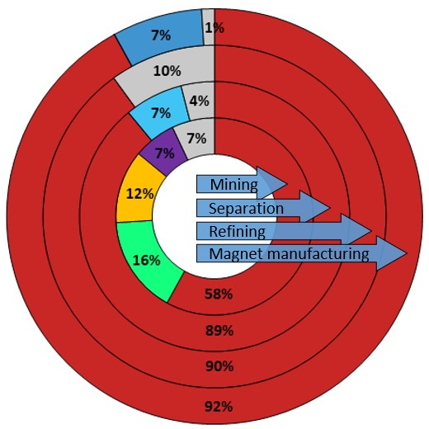
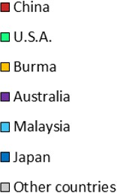
Critical Mineral and Material Supply Chain Vulnerabilities
Supply Chain Vulnerabilities
→ Up-to-mid stream capabilities are concentrated in 1-3 countries
→ Lack of midstream capabilities are a gap that limit growth of upstream supply and downstream value-add manufacturing
Example: Geographic concentration of supply chain stages for sintered NdFeB magnets
Upstream
Mining, Extraction & Concentration
Midstream
Refining & Component Manufacturing
Downstream Manufacturing
Reuse/Recycle
Source: https://www.energy.gov/policy/securing-americas-clean-energy-supply-chain
4

Slide 4
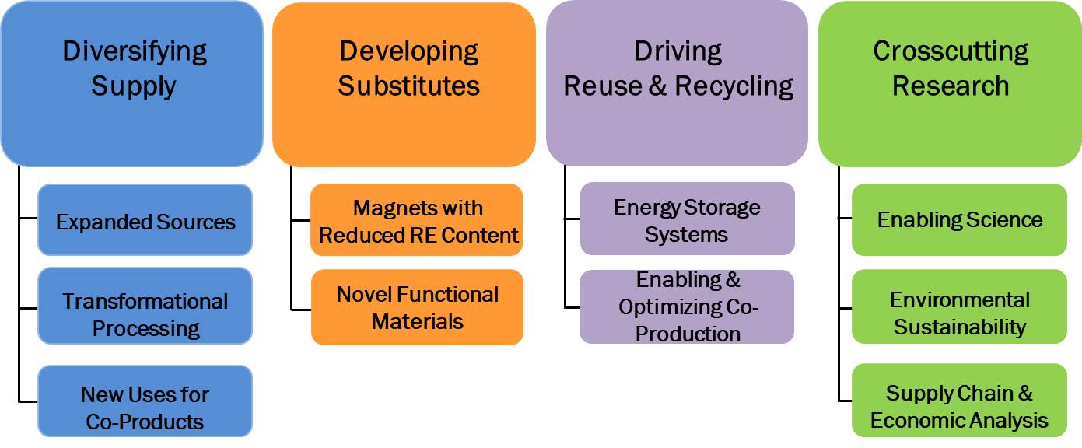
Critical Materials Institute
Portfolio: 46 early-stage research projects that have resulted in 450+ publications and 150+ inventions
Innovative Ecosystem: network of 45+ active team members across critical material supply chains
People: 250+ strong, bolstered by education and workforce development

Slide 5
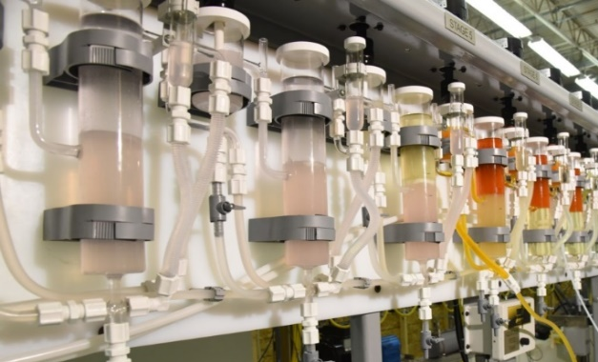
Rare Earth Magnets
Marshallton Research Laboratories plans to scale up commercial synthesis of CMI’s diglycolamide extractants with separation factors 2-3 times over existing extractants.
Alternative low temperature direct metal refining to metals and magnet alloys at a 10 Kg-batch scale by Terves LLC.
Western Digital is currently evaluating the use of CMI’s La-Nd-Fe-Co-B magnet in their hard disk drives.
Recycling of e-waste for magnet recovery by Acid-free methods licensed by TdVib. Pilot plant operations (8000 kg batch size) near completion.
Solvent Extraction Testbed Facility with centrifugal contactor system
Notes:
As we approached year 9 and looking forward to year 10, our emphasis clearly set on translating our technology from lab demonstration scale into demonstrations and pilot scale activities. During the past year there has been a great deal of interest in CMI technology from the private sector.
On this slide and the next I just want to list a few of the significant developments on moving CMI technology forward to a scale ready state. Please remember that CMI scope is early-stage TRL 2-4 research but we work very closely with our private sector partners to ensure a maturation path toward commercialization. In many cases, the work listed in these two slides have benefited from follow-on funding to further mature the technology. In total, CMI technologies have attracted over $22M from a variety of sponsors including SBIR, ARPA-E, TCF and private investments.
In the rare earth magnet supply chain Marshallton Laboratories is working on scaling a new DGA molecule that has greater separation factors than commercially available chemicals. If proven at scale, in the number of separation stages needed would be significantly reduced, resulting in less chemical and water usage and lower capex and opex costs.
Next CMI is supporting several projects to reduce the energy intensity of RE metal production through lower temperature processes. Additionally some of our teams are evaluating the possibilities of creating magnet alloy precursors directly from the salts, eliminating an alloying unit operation.
CMI low Nd magnet formulation is currently being evaluated by Western Digital for inclusion in their Hard drives. I believe David Parker will be providing additional details in his talk tomorrow.
Finally working with our team member, TD-Vib is commercializing acid-free dissolution for the recovery of RE elements from waste magnet streams. Their pilot-scale operations should be on-line at the end of summer.

Slide 6
Timeline of Technology Maturation (2015-2022)
Acid free Dissolution of Rare Earth Magnets

Slide 7
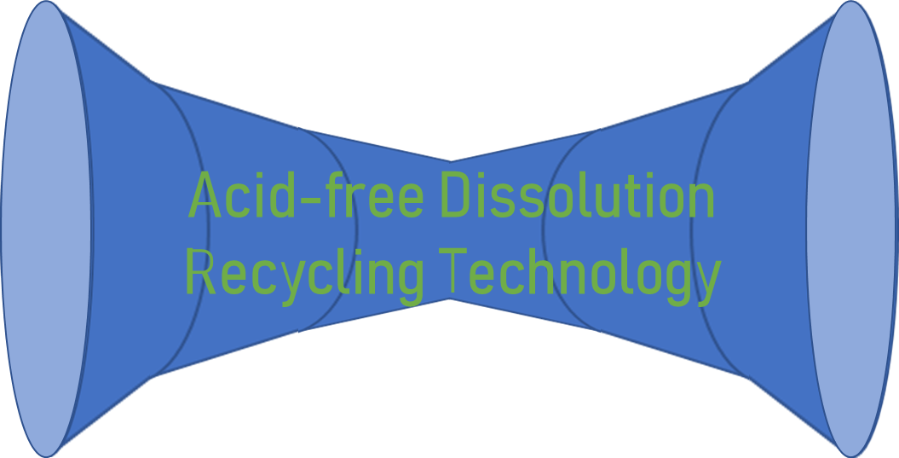
Building Innovation Eco-System for the Acid-free Dissolution
Shredded HDDs
Rare Earth Metals
Magnet Grinding Swarfs
Need More In-take Partners
Need More Off-take Partners
Terfenol-D Grinding Swarfs
Rare Earth Oxides/Oxalate
Scrap Magnets
Available for Purchase
INCLUDES:
Adjusting technology maturation relative to those of other technologies in the ecosystem.
Identifying additional innovation needed to interconnect different technologies at appropriate maturation timeline.
Iterative performance of economic and lifecycle analyses.

Slide 8
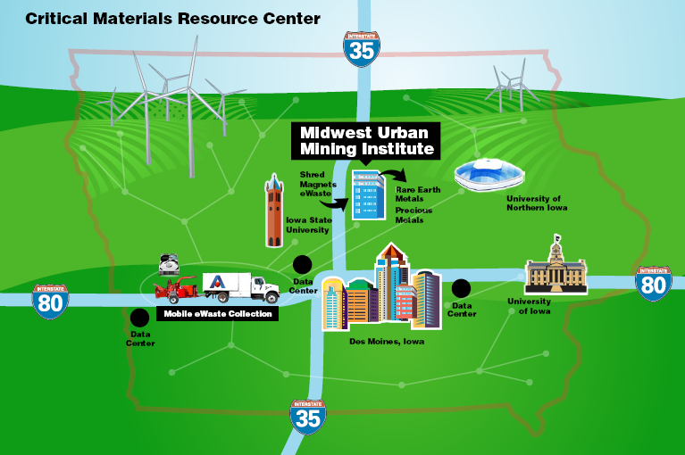
Iowa Critical Material Resource Facility
Iowa CMRF will also recover other economically important metals like gold, platinum, silver, copper, nickel, cobalt, etc. contained in e-wastes.

Slide 9
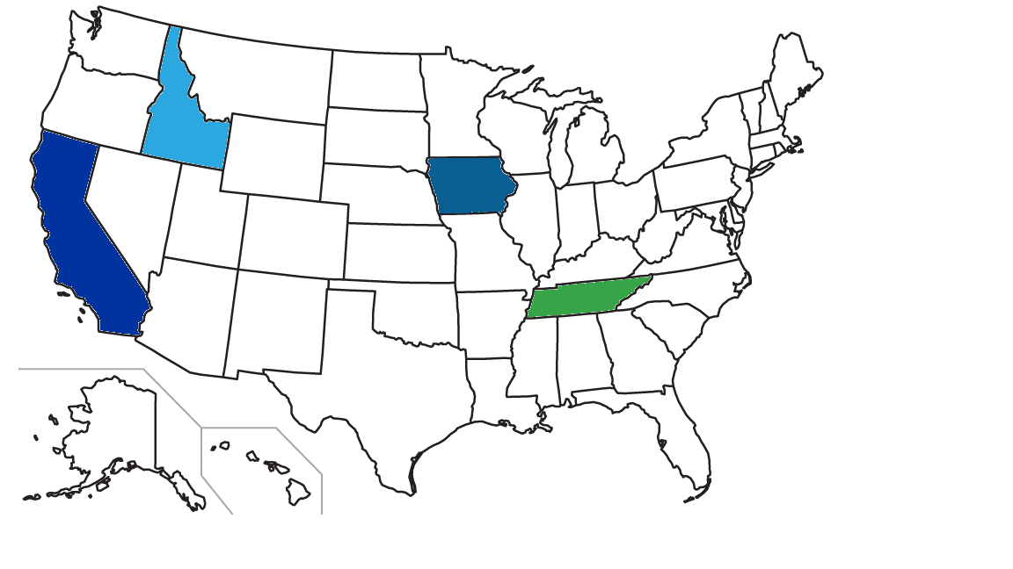
Questions?
2
1
The Critical Materials Institute, an Energy Innovation Hub, is supported by the U.S. Department of Energy, Office of Energy Efficiency and Renewable Energy, Advanced Manufacturing Office.
4
3
1
Ames Laboratory (Ames, Iowa)
2
Idaho National Laboratory (Idaho Falls, Idaho)
Team Members
Affiliates
3
Oak Ridge National Laboratory (Oak Ridge, Tennessee)
4
Lawrence Livermore National Laboratory (Livermore, California)

