Slide 1
Midwest Heat Pump Water Heater Market Landscape

Slide 2
Jacob Serfling Co-Director Policy & Building Technology Midwest Building Decarbonization Coalition
Notes:
"Over the years I have worked in tenants’ rights, community organizing, public policy, and environmental justice. My work centers people of color and low-income families and individuals. I believe that people have far more power than they realize and should lead in decisions that impact their lives. Those most affected by an issue have the greatest reason to invest in generating alternative outcomes. I was drawn to serve on Environmental Initiative’s board by the staff’s willingness to partner with Black, brown, and Indigenous communities in the fight against systemic racism, inequality, and oppression. The value placed on accountability, transparency, and honesty creates a space of trust and continuous improvement."

Slide 3
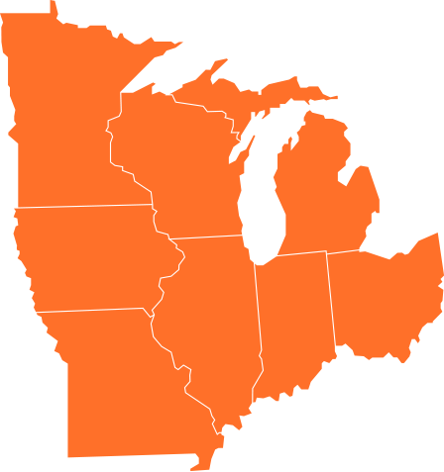
Coalition Overview
Mission: To develop and implement equitable strategies to achieve zero emissions from the Midwestern building sector by 2050.
Regional Priorities:
Michigan
Minnesota
Illinois
Wisconsin
Ohio
Missouri
Indiana
Iowa
midwestdecarb.org
Notes:
Jacob
Mission: To inspire and educate Midwesterners to end new installations of fossil fuel equipment in residential and commercial buildings by 2030, and to achieve zero emissions from these buildings by 2050, with intentional and consistent integration of equity and labor justice across all facets of our work.

Slide 4
New Buildings Institute
Brewery Blocks, Portland, OR Photo: Gerding Edlen Development
A national non-profit organization aiming for healthy buildings that achieve carbon neutrality through research, policy, technical guidance and market transformation

Slide 5
AWHI was launched due to increasing concern over the energy use and greenhouse gas emissions associated with heating water. Today, we facilitate and guide over 140 organizations that are working together to accelerate the adoption of efficient, grid-connected and low global warming potential (GWP) heat pump water heaters.
Notes:
Water heating is generally the second largest energy using appliance in a home, behind space heating. In the United States, we use a lot of energy on water heating – nearly 2 quadrillion BTUs. Our showers, clothes washers, and dishwashers account for about 19- 32 percent of annual home energy use. In some multifamily buildings, water heating is the top source of energy consumption.

Slide 6
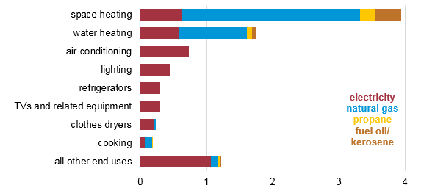
Energy Use in Homes
About 19-32% of energy use in homes is from water heating
Together, space heating and water heating amount to 2/3 of residential energy use.
electricity
gas
propane
fuel oil / propane
Quadrillion British thermal units
Source: 2015 Residential Energy Consumption Survey (RECS)
Notes:
Water heating is generally the second largest energy using appliance in a home, behind space heating. In the United States, we use a lot of energy on water heating – nearly 2 quadrillion BTUs. Our showers, clothes washers, and dishwashers account for about 19- 32 percent of annual home energy use. In some multifamily buildings, water heating is the top source of energy consumption.

Slide 7
What is a heat pump water heater?

Slide 8
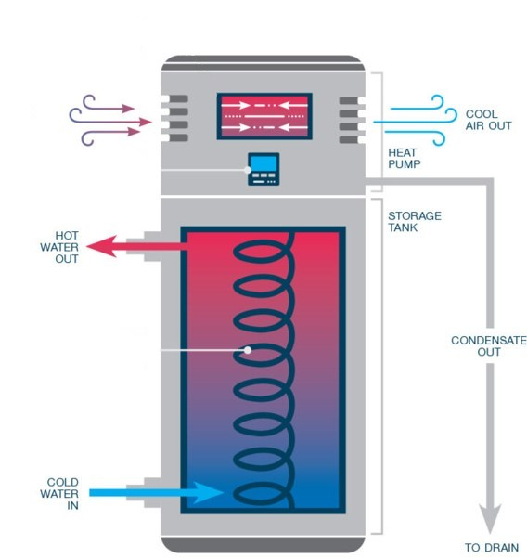
Heat Pump Water Heaters
Similar technology to a refrigerator, but in reverse
Very energy efficient
Higher upfront cost but much lower operating costs
Uses refrigerants
Electrical infrastructure or panel updates may be needed
Notes:
Heat pump water heaters use less energy to heat the same amount of water as a conventional water heater. By extracting warmth from the surrounding air and transferring it to the water inside the tank, heat pump water heaters (HPWH) reduce the amount of energy required to heat the water compared to a conventional water heater. Installation requirements are much like an electric water heater, except HPWHs require a condensate drain and emit cool, dry air.

Slide 9
Heat Pump Water Heaters
Heat pump water heaters are two to four times more efficient than standard water heaters
Notes:
But they cost more, so no plumber recommends them. Few know how to install them, but when you have electric to electric retrofits, they are fairly easy to swap out.

Slide 10
Midwest Opportunities

Slide 11
Water Heating Equipment Fuel Type
NBI estimates in 2020 are based on data from CA Residential Appliance Saturation Study 2009 and 2015 RECS
Notes:
There are an estimated 24.3 million water heaters in the Midwest. A significant proportion of water heating equipment is powered through directly burning of gas in homes, although this varies by region in the US. In the Midwest, about 60% percent of water heating in single family residential buildings is from gas and another 4% comes from propane. Transitioning these systems away from fossil fuels provides substantial greenhouse gas reduction over the life of the water heater. However, gas water heaters may not have the plugs that are necessary for a 240 Volt heat pump water heater. This means high first costs prevent decision makers from buying heat pump water heaters.
Source: 24.3 million water heaters in the Midwest states (as defined by MW BDC in 2022). Source: 2020 RECS, table “Highlights for water heating in U.S. homes by state, 2020”

Slide 12
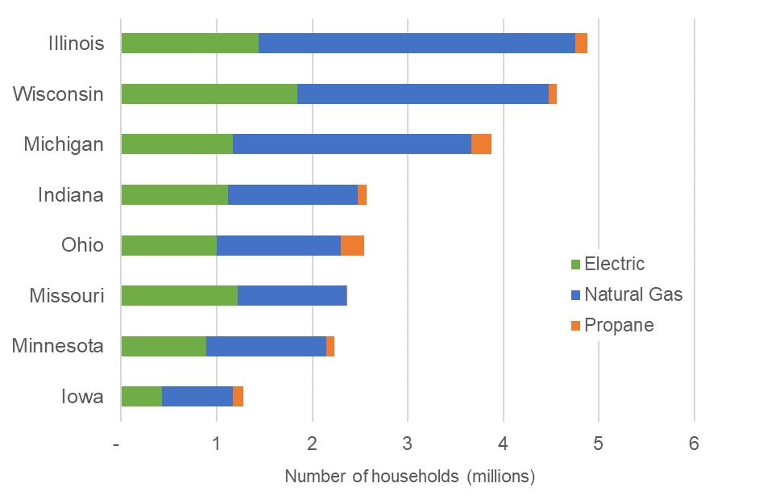
Number of Water Heaters by State and Type
Number of households as well as percentage of existing electric resistance water heaters can generally quantify total water heating market potential
Source: 2020 RECS
Notes:
There are an estimated 24.3 million water heaters in the MW. This chart reports the total number of single family and multifamily households in each state, and the share of existing water heaters by fuel type. Illinois has the most households, but a higher percentage of these households have a gas water heater. Missouri and Illinois have about the same number of electric resistance water heaters in the state, even though one of every two households has them in Missouri. This is because Illinois has nearly 3 million more homes than Missouri. Michigan and Ohio are estimated to have the largest share of water heaters fueled by propane. All of this information is helpful when considering deployment strategies for heat pump water heaters.

Slide 13
In the Midwest, more than 6 million single-family homes could save around $300 a year by replacing their electric resistance water heater with a heat pump water heater.
Estimated number of single-family homes with electric resistance water heaters in
each state
650,000
636,000
842,000
350,000
1,300,000
718,000
900,000
944,000
Source: 2020 RECS
Notes:
Replacing electric resistance water heaters is considered “phase one” of market transformation in HPWH adoption.
In the Midwest region, about 6 million single family homes have an electric resistance water heater. Replacing an electric resistance water heater with a heat pump water heater results in immediate electricity savings, with heat pump water heaters being 3 to 4 times more efficient than electric resistance water heaters.
Replacing electric resistance water heaters in single family homes in 8 MW states could be a savings of $1.8 billion for consumers!

Slide 14
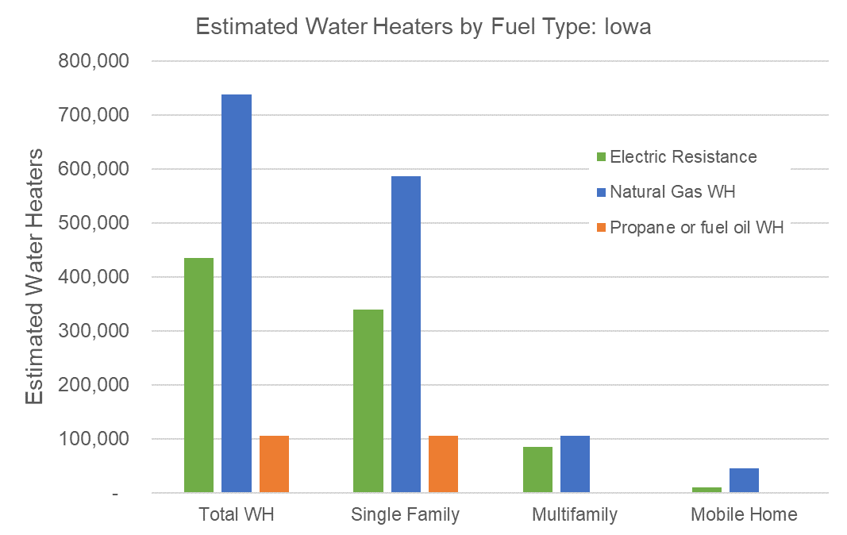
Iowa Water Heater Estimates
Source: 2020 RECS

Slide 15
Electric Resistance to Heat Pump Water Heater Retrofit
Annual energy savings of 72%
Annual cost savings $310
Source USDOE Energy Guide comparison of Rheem 50-gallon HPWH, electric resistance water heater and gas water heater
Notes:
That is why we want to focus on electric resistance water heating to heat pump water heating. See state-specific slides for estimated number of electric resistance water heaters installed.

Slide 16
Solar panels required to power electric resistance and heat pump water heater for one year
An electric resistance water heater requires
8 solar panels to power it for a year
A heat pump water heater requires 2 solar panels to power it for a year
Notes:
This annual comparison of energy used by water heaters and energy generated by solar panels shows the importance of efficiency!! An electric resistance water heater uses the equivalent of about 8 solar panels each year. On the other hand, a heat pump water heater only uses about 2 solar panels worth of electricity each year.
Because of tax incentives, rebates and variable installation costs, exact costs may vary but HPWH will be much less expensive (usually 2-5x) solar on a kilowatt hour saved basis. New financial incentives due to the Inflat
Each solar panel costs $1000 - rebates
Our spreadsheet on HPWH to Solar comparison costs - https://docs.google.com/spreadsheets/d/1f-v1qPJyWm6xQjOHmmdL3oWLBv9V4IZPitjpEevj1jo/edit?usp=sharing

Slide 17
Challenges

Slide 18
Technical Challenges
Electrical panel may not have room for additional load
No 240 Volt plug nearby
Replace gas powered water heaters with HPWH costs more today due to these added infrastructure costs
Notes:
There may be some additional technical challenges with installing a heat pump water heater, especially when replacing gas equipment.
Older homes may have a 100 AMP (or less) panel that may not have space for an additional 240 V circuit if a home is changing from gas to electric. This would potentially require a panel upgrade which can be expensive.
If a home is switching from a gas water heater, there may be no electricity present at the water heater and it is unlikely there will be a 240V plug. This would require running a 240V line from the panel which can be expensive.
For both of these challenges, the emerging 120V HPWH may be a potential solution. This water heater plugs into a normal outlet and Rheem released the first model for sale in California in July 2022. Manufacturers are working on cold climate versions of this 120V HPWH.

Slide 19
Challenges and Potential Solutions
Challenge
Solution
Upfront Cost
Programs / Rebates / Financing
Programs and Rebates
Finding an installer
Installer Finder / Workforce training
Notes:
We can create rebates to help with the upfront cost of heat pump water heaters. We can leverage other programs like weatherization, where we can braid funding from multiple program sources.
The Inflation Reduction Act, signed in 2022, has tax credits for heat pump water heaters. The details are still be being worked out but good resources to track your eligibility and the amount you will be able to receive are the Energy Star
- https://www.energystar.gov/about/federal_tax_credits/non_business_energy_property_tax_credits and the rewiring America calculator - https://www.rewiringamerica.org/app/ira-calculator
Many utilities and energy offices also have programs for HPWH rebates – try the ENERGY STAR rebate finder or contact your local utility - https://www.energystar.gov/rebate-finder?page_number=0
A 2020 study by PNNL found over 70 programs in the MW states,
Finding an installer can also be a challenge. Across the country there are a lack of HPWH installers. The Inflation Reduction Act sets aside $200M for states to develop clean technology workforce training programs. This could include HPWH training. Additionally ENERGY STAR has a water heater installer finder that can help locate qualified installers near you - https://www.energystar.gov/productfinder/water-heater-installers/

Slide 20
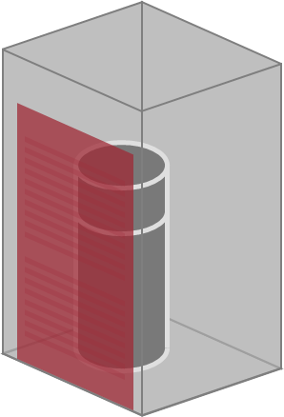
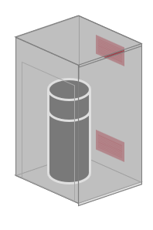
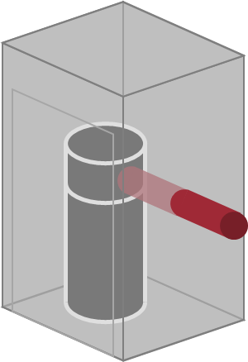
Questions and Myth Busting
Where to install a HPWH?
How much air do they need?
Do they cool a space?
Are they hard to install?
Do they make a lot of noise?
Do they work in cold climates?
Notes:
There may be a lot of myths or questions about HPWH like
1) Where do I put one? The ideal location for a HPWH is a garage or basement. But they can also go in utility closet. They're just like other water heaters they just need a little bit of air and a place to run a condensate line. One of the great things about HPWH is that they dehumidify a space
2) How much air do they need? Some manufacturers recommend 700 cubic feet of air which is a 10' x 10' room with low ceilings. But after a recent study by NEEA, some are changing that to 450 cubic feet. Also, if you put a vent or louvered door or duct a HPWH it works great even in tight spaces
3) Do they cool a space? All HPWHs exhaust is cool air. This can cool a room a little bit which is nice in the summer and maybe less so in the winter. You'll see a little cooling in the room the HPWH is in but not much and this is welcome in many rooms like hot garages
4) Are they hard to install? HPWH install like any electric water heater with plumbing and electrical connections. The only difference is the condensate line that should be drained somewhere that can receive water
5) Do they make a lot of noise? HPWH compressor noise falls between 45-55 decibels. 45 db is the sound that a quiet dishwasher makes. HPWH don't make much noise but it is a new noise in your house.
6) The short answer is yes. HPWH work in the temperature ranges between 35-120 degrees. Most water heaters even in the cold northern parts of the countries are in spaces that don't fall below 35 degrees. Maine is the #1 state in the US for HPWH adoption. Most water heaters are found in basements where HPWH work great. Even below 35 degrees HPWH will work but in electric resistance mode so they will be less efficient for the rare times it drops below that temperature.

Slide 21
Heat pump water heater program design models

Slide 22
Steering Committee Concerns
Renters
Lack of decision-making power
Ability to access existing incentives
Jobs and Business Development
Added assistance to underrepresented groups
Keeping economic AND emission benefits in target communities
Affordability
Equipment and ancillary Costs
Protection against higher utility bill
midwestdecarb.org
Notes:
Jacob

Slide 23
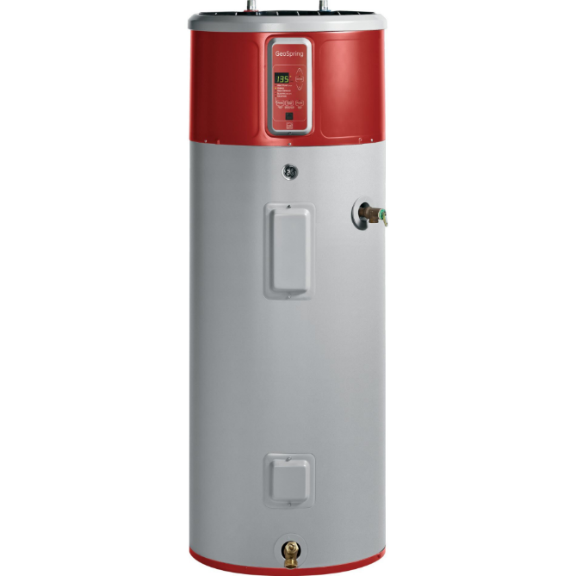
Efficiency Maine HPWH Program
Maine averages 10,000 installs annually
Mainers save 3x in operating costs over other water heaters
60% market share for heat pump water heaters
$850 instant discount at box stores or mail-in rebate
Any installer (including self-install)
Distributor program
$50 to distributors for administrative work
Distributors provide data to Efficiency Maine
Notes:
Efficiency Maine offers multiple HPWH programs to help drive the adoption of heat pump water heaters from consumer rebates to a distributor focused program
10,000 HPWH are sold through retail or distributors per year which represents a 60% market share
Maine offers $850 instant (at big box stores) and mail in rebates for customers with any installer including DIY installs. This brings the price of a HPWH similar to an electric resistance or gas water heater
Distributors also receive rebate along with a $50 per water heater for their administrative work – in return the distributors provide data to Efficiency Maine

Slide 24
Efficiency Maine – Low Income Program
Identify and prescreen eligible candidates
19 participating installers throughout the state
Plus many distributors
Replaces all fuel types (including oil + propane)
And other efficiency measures like LEDs and showerheads
Free to customer
Efficiency Maine pays $1350 per water heater
Installer agrees to fixed price of $2,500 all in
Notes:
Eligible candidates
Efficiency Maine (EM) uses lists of people receiving federal or state low income benefits to identify potential LMI candidates.
They send out mailers to prospective candidates and ask them to call the call center
The call center then prescreens candidates and sends information to installers
Installers + Distributors
It has been a challenge for Efficiency Maine to find installers who will meet the fixed price requirements of $2,500
Installer holds all costs until claim form is submitted
There are many participating distributors in the program
Oil and propane replacements
Only example in the country of a program that is fuel neutral – homes can receive new water heaters regardless of the fuel they use to heat their water
LEDs, Aerators, showerheads also available (bundling for higher cost-effective projects)
Pricing
Water heaters must have 10 year warrantee, 50 gal, UEF 3.39 or greater, Energy Star
Installers agree to a fixed price of $2,500 all in with $1,350 for the water heater
Replace about 1,000 water heaters per year through this program
This is the gold standard of low income state programs nationally
Presentation by Efficiency Maine in link below
https://drive.google.com/file/d/1jaYLtKmuA0LlK1MQXenkG7bYMF60dq_e/view?usp=sharing

Slide 25
San Joaquin Valley, California DAC Pilot Projects
11 communities
250 projects are complete
Free electrification measures
Program includes induction stove/ HPWH/ heat pumps/ electric dryer
Extensive community outreach
Notes:
The nonprofit Self Help Enterprises is part of the team leading the San Joaquin Valley DAC pilot project
This project provides free electrification measures to customers in eleven small, underserved communities in the San Joaquin Valley. The program is designed to help households switch from propane or wood burning appliances to efficient electric ones like heat pumps and induction stoves.
Self Help Enterprises (SHE), a nationally recognized community development and affordable housing organization, is a key partner on the project. SHE’s role is to help community members manage the transition to clean energy by working side by side with residents on the ground. SHE has enrolled over 950 families in the program since the project kick off in February 2020, and 250 of the electrification projects have been completed as of spring 2022.
The program has seen significant success to date but has also learned important lessons on the opportunities and challenges in electrifying homes within disinvested communities.
First, SHE has found that having a community-based organization (CBO) on the project team provides a crucial level of trust
Second, when helping communities to electrify, SHE believes programs should plan for “electrification hesitancy”. Even though the appliances and installations in the San Joaquin project are free, there is still some hesitancy on the part of participants in going all electric because of perceptions of higher fuel costs. SHE conducts education sessions to show the efficiency of heat pump and induction technologies, and this helps ease these concerns.
The good news is that SHE has found that as installations increase in a community so does interest from hesitant and harder to reach community members. Once these members see their neighbors loving induction stoves and enjoying hot water heated efficiently from heat pump water heaters, they are more eager to participate in the program.
Finally, SHE has found that creating user friendly educational materials and offering residents opportunities to test efficient electric appliances (for example portable induction cooktops) decreases barriers and increases participation in the program.
Self Help Enterprises and the San Joaquin Valley DAC project is ensuring that low-income communities should be prioritized in the clean energy transition. As the program continues to equitably electrify hundreds of homes, its lessons learned will become a key resource as the rest of California and the nation seek to follow their example.
https://efiling.energy.ca.gov/GetDocument.aspx?tn=242592
Joe to finish notes

Slide 26
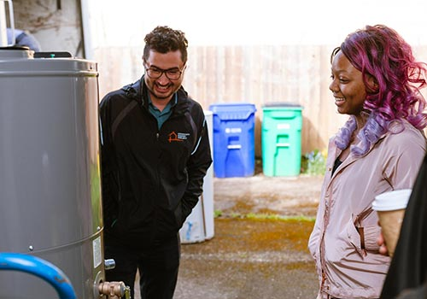
North Carolina
Incorporating HPWH into Weatherization Programs
Streamlining of administrative burden by sharing applications across agencies
Looking into:
Bulk purchases
On bill financing
Notes:
Another Low-income program for HPWH to note is happening in North Carolina with programming from the nonprofit NC Justice Center
NC Justice center is incorporating HPWH into weatherization programs for low income households. They are training weatherization staff and searching to streamline administrative work for households by combining all incentives under one umbrella and asking participants to fill out just one set of forms.
North Carolina Justice Center is also hoping to reduce barriers to accessing heat pump water heaters by buying HPWH in bulk and giving the discounts to income qualified households

Slide 27
Pembroke, IL Rural Residential Electrification Pilot
The Midwest BDC is working with the Community Development Corporation of Pembroke Hopkins Park (IL), RMI, Slipstream, and local labor to demonstrate a decarbonized future with an electrification pilot in this rural community.
Johari Cole-Kweli
Pembroke CDC, Board Member
Lee Ringo
Pembroke CDC, Project Consultant
Notes:
Jake
Pembroke, IL Rural Residential Electrification Pilot: Johari Cole Kweli (CDC-PH, IL), Lee Ringo (CDC-PH, IL)

Slide 28
Workforce training programs
Notes:
We found no current certification training program for heat pump water heaters. State-level requirements for installation of water heaters vary, and one of our next steps is to look into what these requirements are in each state.

Slide 29
Heat Pump Water Heater Workforce Development Opportunity
Some states have a low barrier to entry
Can get an installer certificate in three months
Currently not enough installers to meet demand in some geographic areas
Great Northwest as an example
Notes:
Example of workforce development opportunity, this company, Great Northwest, that does nothing but heat pump water heaters
Great Northwest - Both emergency and proactive replacements
Some areas of the country have high HPWH market penetration already, including the Pacific NW and Maine.

Slide 30
Emerald Cities Collaborative HVAC Training Academy
12-week training course on space heat and cool pumps
Focused on BIPOC and low-income community members
Trainees receive four certificates upon completion
Trainees receive assistance with childcare, transportation and meals
Notes:
Emerald Cities info https://emeraldcities.org/wp-content/uploads/2022/06/HVACR-Training-1-Pager.pdf
Weatherization programs – Some weatherization programs are starting to install water heaters – Find your local program by going here - https://www.energy.gov/eere/wap/how-apply-weatherization-assistance

Slide 31
Renewable Energy Installation Workforce
Wisconsin Green Muslims
In partnership with Rise Up Solar where the goal is to enable community-focused nonprofits to harness the environmental and economic benefits of solar power.
Notes:
https://wisconsingreenmuslims.org/faithsolar/ - scholarship training program; free training; no previous solar experience required; launch career in clean energy economy
Rise Up Solar - https://www.riseupsolar.com/

Slide 32
Weatherization Program Opportunities
Ensure Justice40 investments benefit BIPOC disadvantaged communities
Limit deferrals – allow for 15% of funding to go for health and safety cost category for updates
Allow for fuel switching from gas to electric
Consider the societal cost of carbon in calculations
Braid WAP funding with other programs
Notes:
Weatherization measures don’t cover health and safety interventions to homes such as building structural repairs, lead, mold, or asbestos that impact housing quality. Without addressing health and safety issues, houses can be deferred from WAP and left without assistance in helping them make these upgrades. While WAP funds cannot address all health and safety issues in a residence and deferrals may still occur, states can utilize some WAP funds for health and safety interventions that will reduce program deferrals. Per the DOE’s guidance for BIL WAP applications and the latest Health and Safety Program Notice, WPN 22-7, states have new guidance on making the most of health and safety interventions with WAP funds.
We recommend DOA establish and submit a distinct and separate health and safety cost category in their budget.This health and safety cost category will allow health and safety funds to be excluded from Average Cost Per Unit calculations and cost justification requirements, which could allow for greater investment in a residence to address more holistic interventions.Health and safety budget requests of up to 15% require only typical DOE review, states that wish to request more than 15% may do so but will trigger additional DOE review and justification requests.
We also recommend DOA ensure applications for Program Year 2022 Weatherization Readiness funds are complete and submitted. The Readiness funds are additional to the annual Program Year 2022 allocations and are specifically designed to avoid deferrals by funding critical pre-weatherization interventions like health and safety measures.

Slide 33
Heat pump water heater products and manufacturers

Slide 34
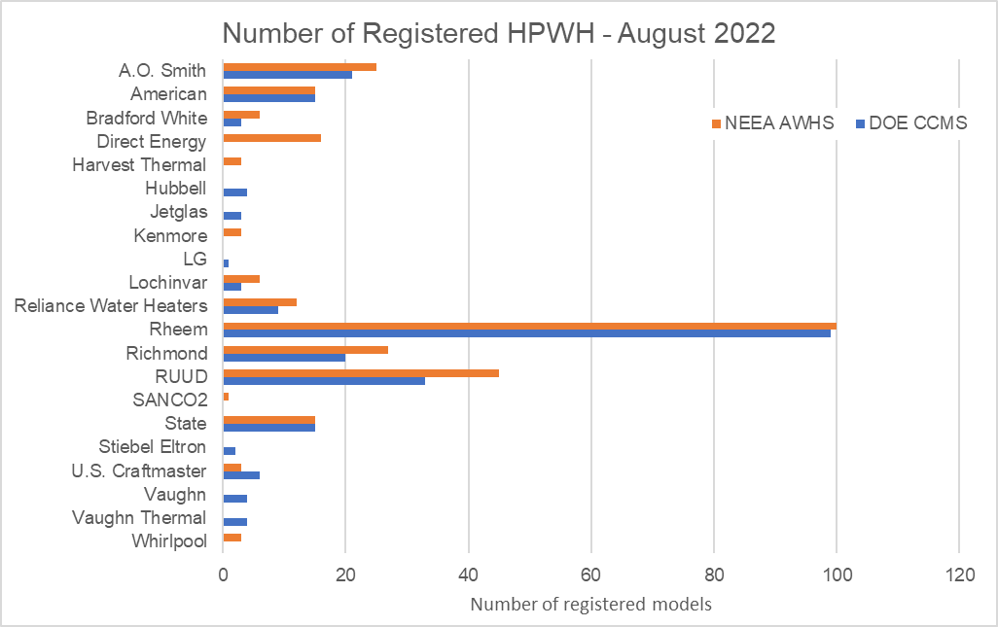
HPWH Technology Update
240V Technology
21 unique brands
240+ models available
Listed on two qualified product lists:
NW Energy Efficiency Alliance
U.S. Department of Energy
Source: NBI 2022 – from NEEA Advanced Water Heating Specification Qualified Products List and DOE Compliance Certification Database
Notes:
This list shows the brands with heat pump water heater offerings. Note that some brands, such as Ruud, are a subsidiary of Rheem.
This information was pulled from the U.S. Department of Energy Compliance Certification Database and the NEEA Advanced Water Heating Specification Qualified Products List and is current as of August 1, 2022. Note that this is not an exhaustive list – it only includes water heaters that have gone through either of the testing protocols required to be listed in the respective database and it does not include commercial heat pump water heaters offered by brands like Mitsubishi or Nyle. Some of the listings, such as the SanCO2 (made by Eco2Systems) are a split system and can be used for single-family or multifamily applications.

Slide 35
Heat pump water heater technology update

Slide 36
Heat Pump Water Heater Characteristics
Grid Connectivity
Integrated hardware allows HPWH to "communicate" with the utility
ANSI standard CTA-2045 specifies protocols, branded as EcoPort
EcoPort Qualified Products List is under development
Refrigerants
HPWH rely on refrigerants, measured by global warming potential (GWP), to transfer heat
Most HPWH use high-GWP 134A
Low-GWP CO2 refrigerant offerings are coming into the market
Notes:
There are two important technology considerations related to heat pump water heaters: grid connectivity, and refrigerants. Grid-connected water heaters that can communicate with the electric utility are critical to help regulate grid load, especially as more homes electrify and add load to the grid. Most heat pump water heater manufacturers are offering integrated hardware that complies with the communication requirements set forth in ANSI standard CTA-2045. States are adopting and considering grid integration requirements for water heaters in their energy codes (particularly CTA-2045). As the market for CTA-2045 compliant water heaters are currently mainly HPWHs, this is effectively a requirement for HPWHs.
Refrigerants are another important consideration. Unlike gas or electric resistance water heaters, HPWH require a refrigerant to efficiently transfer heat to water in the tank. Not all refrigerants are created equal – some have a much higher global warming potential than others. This matters when it comes to equipment end-of-life as well as in the rare occasion that the refrigerant should leak. Most heat pump water heaters on the market today use 134A, which has a high global warming potential, but low-GWP offerings are starting to be offered.

Slide 37
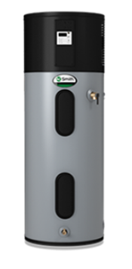
240V Heat Pump Water Heaters
Manufacturer​ | Gallons | Grid Connectivity: CTA-2045 Port​ | Refrigerant​ | Type
A.O. Smith ​ | 50, 66, 80 | Available on certain models​ | 134A​ | Packaged system, Hybrid (ER* backup)
Bradford White | 50, 65, 80 | Available on certain models | 134A​ | Packaged system, Hybrid (ER* backup)
ECO₂ Systems (split system) | 43, 83, 119 | Available on certain models | CO₂ | Split system, Hybrid (ER* backup)
Rheem | 50, 65, 80 | Available on certain models | 134A | Packaged system, Hybrid (ER* backup)
Stiebel Eltron | 58, 80 | Available on certain models | 134A​ | Heat pump
*Electric resistance
Source: AO Smith
Notes:
240V heat pump water heaters are a decades old technology and are widely available and accepted in the market today. This table provides an overview of some of the most common brands available in the market today and is not meant to be an exhaustive list. Most models have at least one electric resistance backup element, which can supplement hot water needs in times of high demand, as noted in the table. Most units are also a packaged system, as shown in the example photo, which means the compressor and tank are both part of the unit. ECO2 Systems is a split system, which means the compressor is separate from the hot water storage tank.

Slide 38
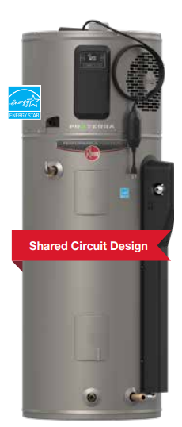
120V Heat Pump Water Heaters
Manufacturer​ | Gallons | Grid Connectivity: CTA-2045 Port | Refrigerant​ | Market Availability | Type
A.O. Smith ​ | 40, 50, 66, 80 | Y​ | TBD | Expected 2023 | Packaged
GE​ | 50, 65, 80 | Y​ | 134A​ | Expected 2023 | Packaged, Hybrid (ER* backup)
Nyle E8​ | 50, 80 | Y​ | R513A​ | Available | Split system
Rheem ​ | 40, 50 | Y | 134A​ | Available | Packaged
 | 40, 50, 65, 80 | Y | 134A​ | Available | Packaged
*Electric resistance
Source: Rheem
Notes:
The plug-in 120V unitary HPWH is an emerging technology in development by four manufacturers. Eliminating the need for expensive panel upgrades and/or home rewiring, the 120V heat pump water heater represents an ideal solution for retrofit applications to replace existing gas-fired tank type water heaters. The technology is expected to be well-suited to smaller homes with lower hot water demand. Most units are designed to operate on a shared 120V/ single phase circuit with a 15 amp breaker size.

Slide 39
Central heat pump water heaters for multifamily buildings

Slide 40
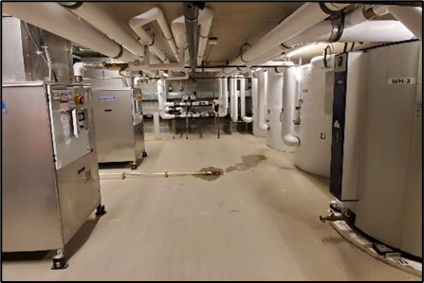
Commercial Heat Pump Water Heaters
Multifamily buildings may have a centralized domestic hot water (DHW) system instead of a water heater in every unit
Commercial HPWH use heat pump technology and can replace inefficient existing boilers
More complex than conventional systems, but offer operational savings and decarbonization
Photo: Ecotope, Inc.
Notes:
Multifamily buildings that have a centralized DHW system are traditionally fueled by gas boilers. Commercial heat pump water heaters use heat pump technology to heat water more efficiently. These systems are much more complex than a standard single-family water heater, and are typically a split system, meaning the water storage tanks are separate from the condensing unit.

Slide 41
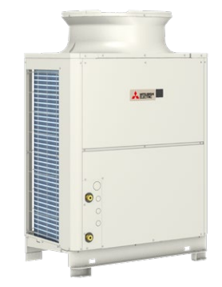
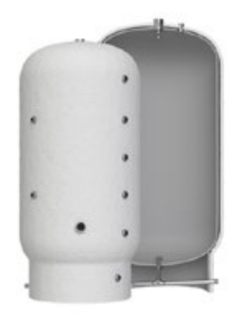
Commercial HPWH
Manufacturer | Grid Connectivity: CTA2045​ Port | Refrigerant​ | Packaged (skid mounted) option?
ECO₂ Systems | Available on certain models | CO₂ | Water Drop
Nyle​ | Y | R513A​ | -
Colmac​ Waterheat | -​ | 134A, 410A​ | -
Lync by Watts | - | R744 | -
Mitsubishi | Y | CO₂ | Origin by Steffes
Source: Mitsubishi
Notes:
Central heat pump water heater systems designed to serve a multifamily or commercial load (typically with more than 120 gallons of storage volume) are available in the market. The table below provides a summary of the commercial HPWH that are currently available in the market. In 2021, the AWHI Commercial Working Group worked to promote packaged, skid-mounted, “plug and play” solutions to increase the ease of market adoption. These “plug and play” solutions streamline the design process by housing all the key components of the system in one package, thus decreasing complexity and cost. Key forthcoming “plug and play” packaged products that utilize heat pump water heaters are noted in the table.

Slide 42
Thank you

