Slide 1

Understanding the Energy in your Facility
By Brandon Umscheid and NICK FREUND

Slide 2
Agenda
Introductions
Why is Digital Power Important
What is Digital Energy
How to get digital Energy
Power Quality and Why it Matters
Improvement Process
Digital Platforms

Slide 3
Objectives from Today
Compare energy usage with easy to use charts/graphs/reports to better understand where energy usage is.
Analyze the different power quality issues that can be wasting energy.
Understand how poor power quality increases energy usage.
Apply mitigation techniques to improve power quality and reduce energy usage.

Slide 4
Why is Digital Energy Important
Smart buildings require smart power. Most public, commercial and industrial buildings are not energy efficient, representing an enormous untapped potential for decarbonization and sustainability efforts, as well as utility bill savings.
Power digitalization helps facility management:
Reduce energy, costs and Co2
Meet Sustainability Goals by reducing emissions
Maximize Power Availability by avoiding unplanned downtime from power failures
Improve electrical safety

Slide 5
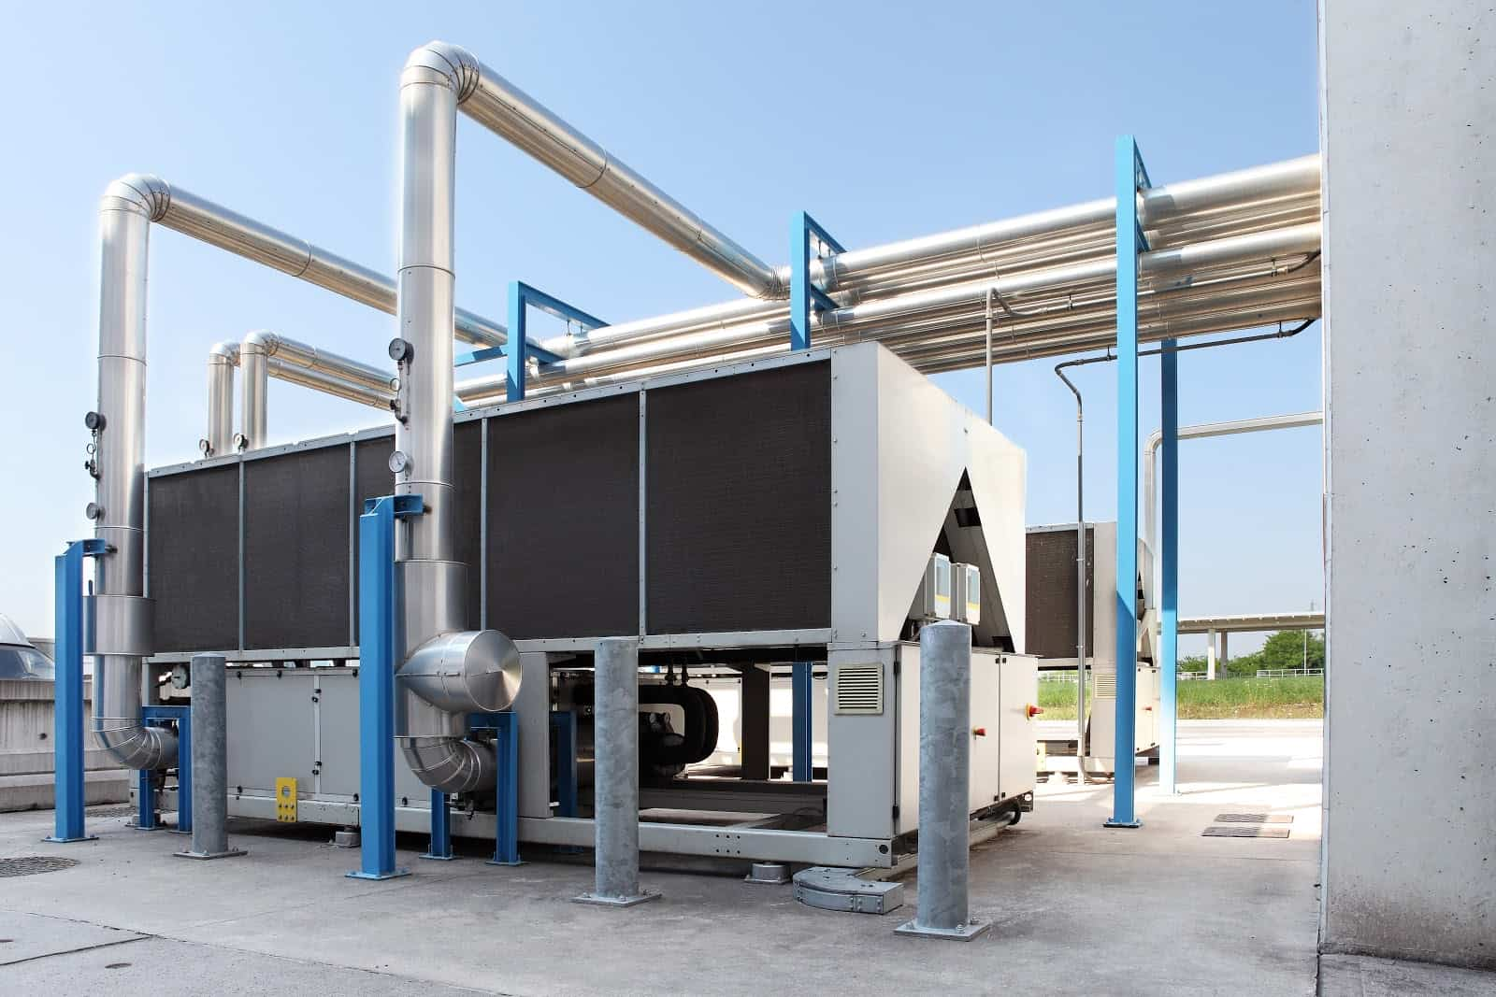
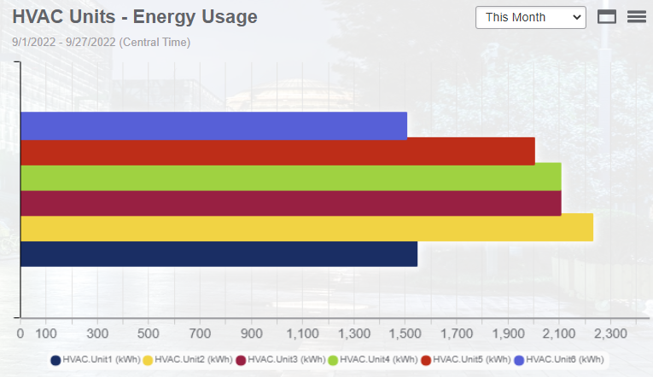
What is Digital Energy
Who has heard of Industrial Internet of Things (IIoT)?
Its taking a physical device and turning it into data that can be analyzed.
Notes:
Discuss IIoT and how digital representation of actual stuff. Data helps us make decisions.

Slide 6
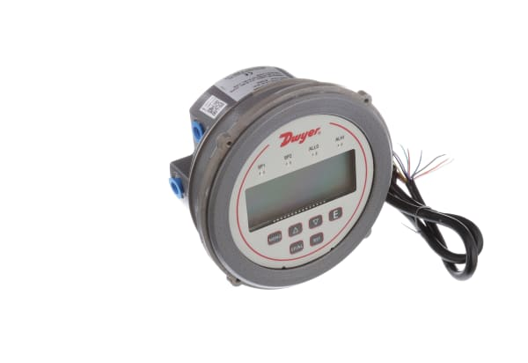

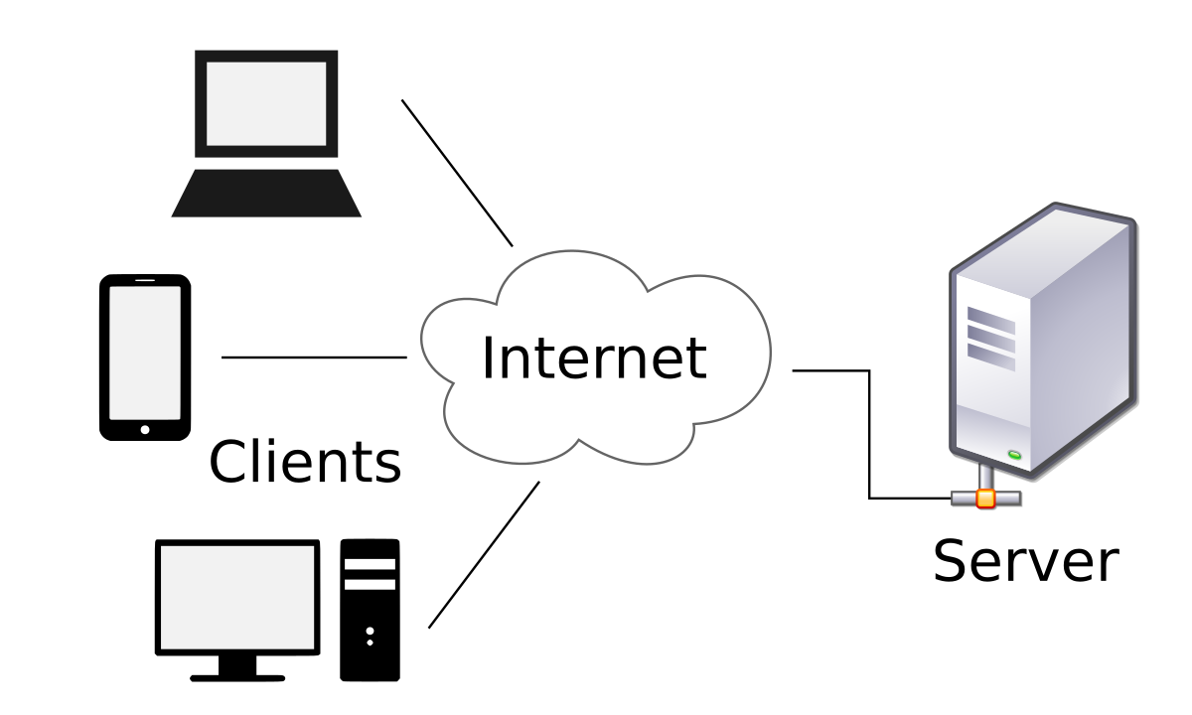
How to Make Energy Digital
Internal Network or Cloud
Water/Gas Meters
Power Meters
Notes:
Talk about installing meters. Talk about how to network them. Systems can be internal network only or completely cloud hosted

Slide 7
What is Power Quality
Sags/swells
Overvoltage
3-phase balanced
Power Factor
Notches
Harmonics
Spikes
Phase unbalanced
Flicker

Slide 8
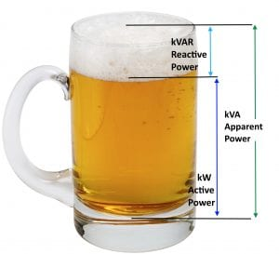
Power Factor Example
Poor power factor means that energy is being wasted. You pay for the full glass so you want it full of beer and not foam.
Imagine the beer glass being the amount of electrical capacity a building has. The liquid is the amount that can be used but you pay full price regardless of the mix.

Slide 9
So What's the Big Deal?
Poor power quality will cause you to pay for energy that you cannot use. On top of that some utilities make you pay a penalty for having a bad power factor and harmonics.
This wasted energy is still a demand on your power distribution equipment. If you can fix it then you free up energy availability and save money.
Today, electrical installations are exposed to a great deal of power quality problems; 80 percent of these disturbances are typically generated by installed equipment.
  In industrial facilities, for example, such disturbances can be caused by non-linear loads like arc welders or variable speed drives, capacitor switching, or large motor starts.
  In commercial buildings, electronic equipment like computers, UPS, and servers may also generate additional power quality disturbances.
Bad power quality also causes equipment to fail faster then expected and can cause equipment to intermittently shut down when you don’t want it to. This is highly important in critical facilities.

Slide 10
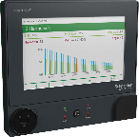
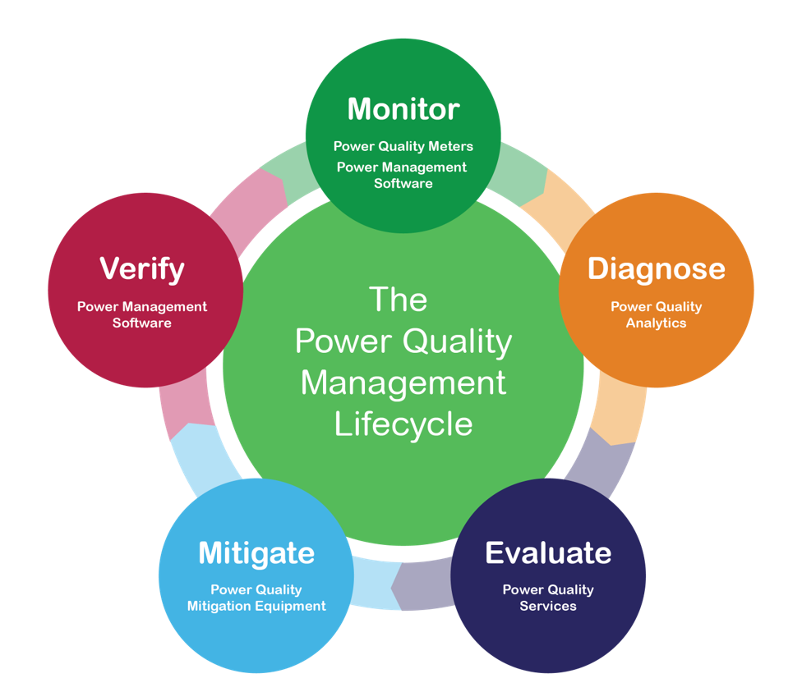
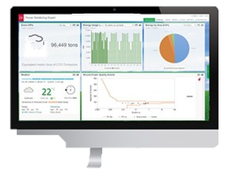
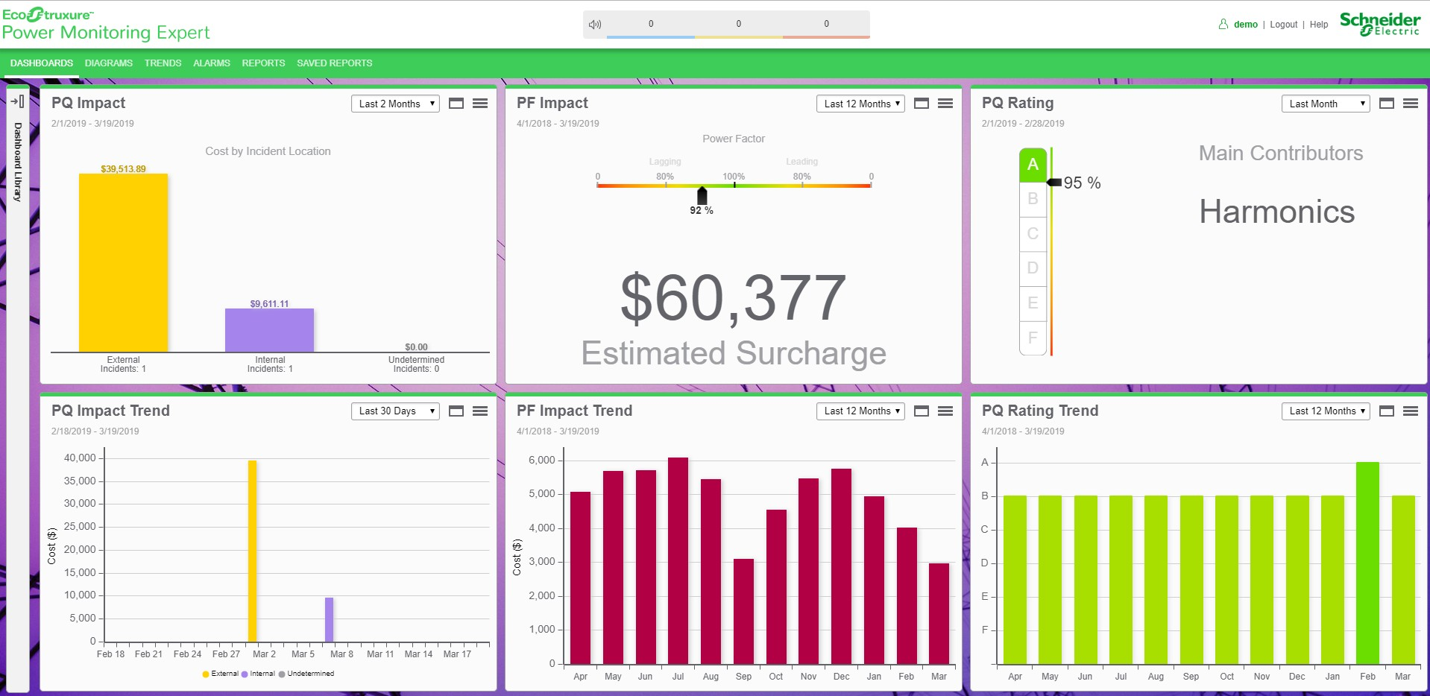
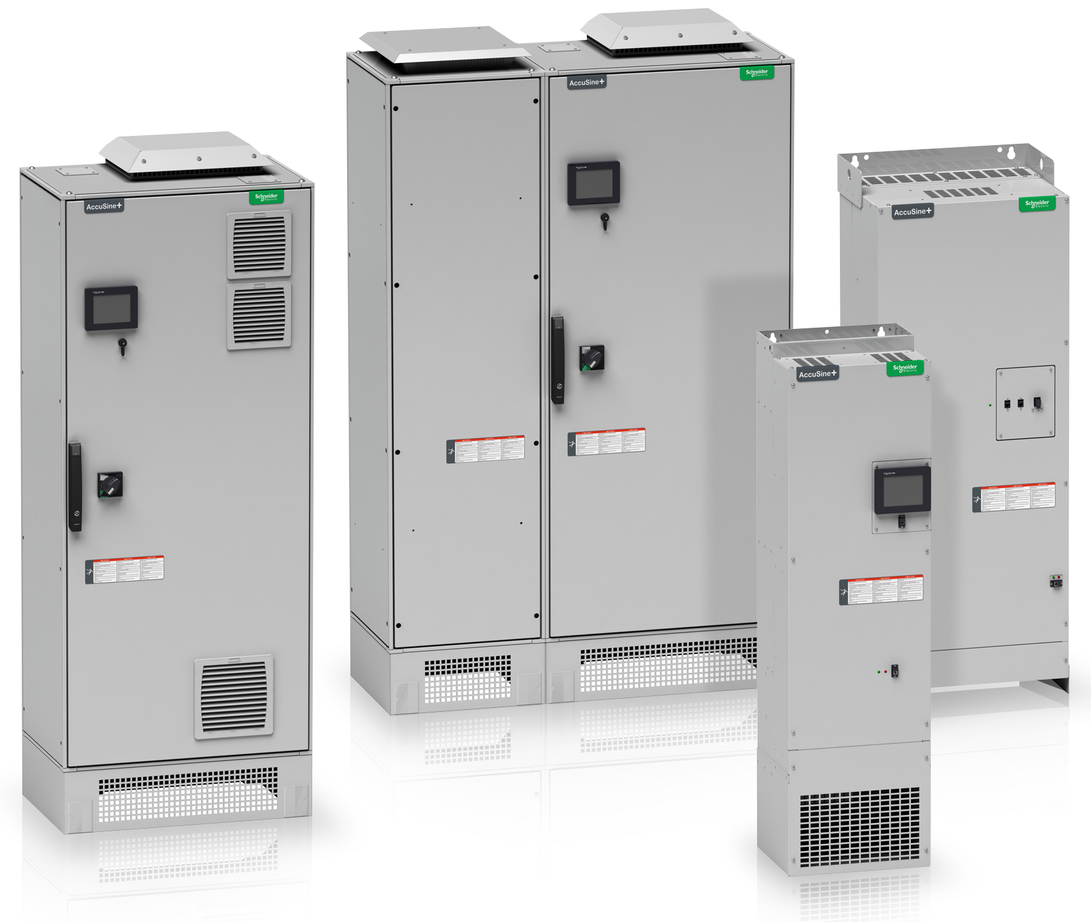

Improvement Process

Slide 11


Mitigation
There are multiple solutions to fix power quality. The first step is to find out what the problem actually is. Get a meter on their main feed and start taking data
There is equipment that can be installed that will correct all of these issues. Some of it is very basic and some of it is very complex.
Sometimes the solution is to replace equipment with more energy efficient equipment

Slide 12

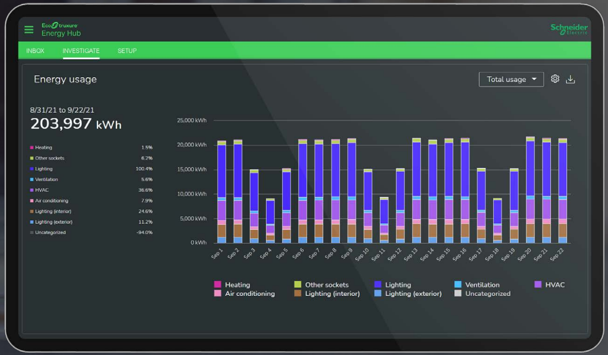
Energy Hub
Gain energy awareness, baseline energy usage,
identify areas to focus, set targets and take action.
Comply with building energy codes
Track usage by load type (HVAC, lighting, and plug loads)
Aggregate energy by site, building, floor, area, and zones
Report energy usage monthly, daily, and hourly
Notes:
Show Demo of Energy Hub

Slide 13
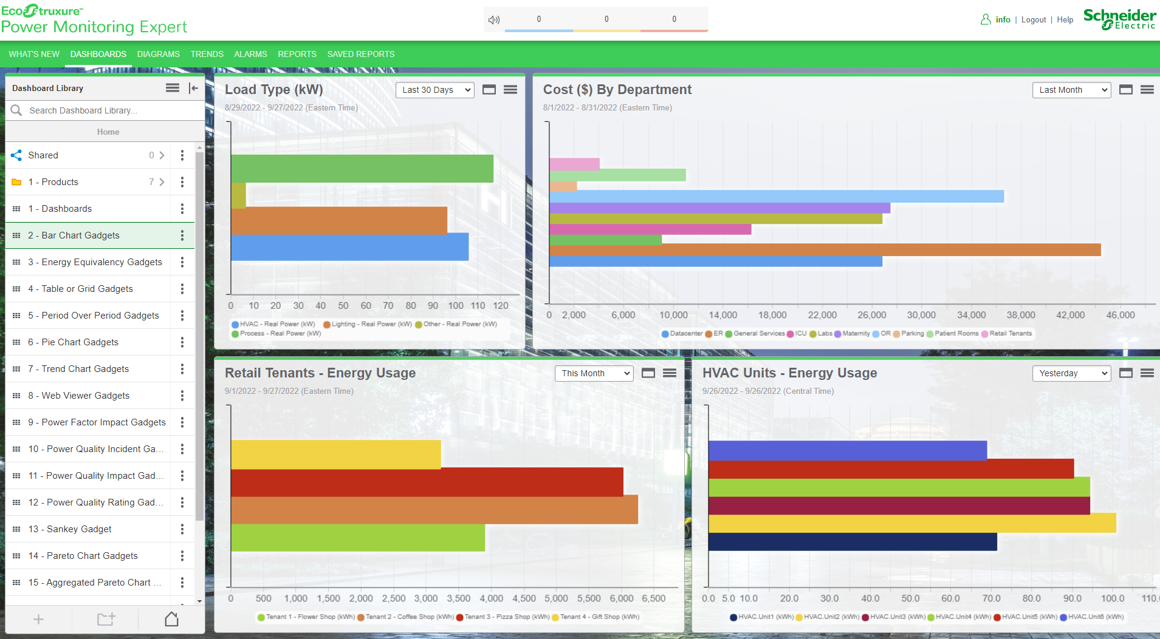
Power Monitoring Expert
Gain insights into the reliability and power quality within an Electrical Distribution Network
by enabling End Users to:
Understand probable cause of Power Quality events
Forecast consumption based on energy models
Automate emergency power test reports (generator & ATS)
View Green KPI’s and emissions through dashboards
Notes:
Show Demo of PME

Slide 14
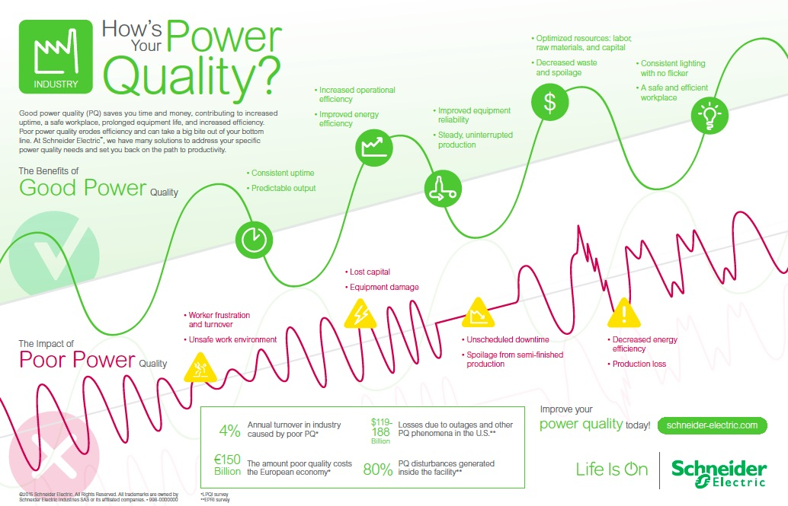
Questions?
Notes:
Conclude

