Slide 1
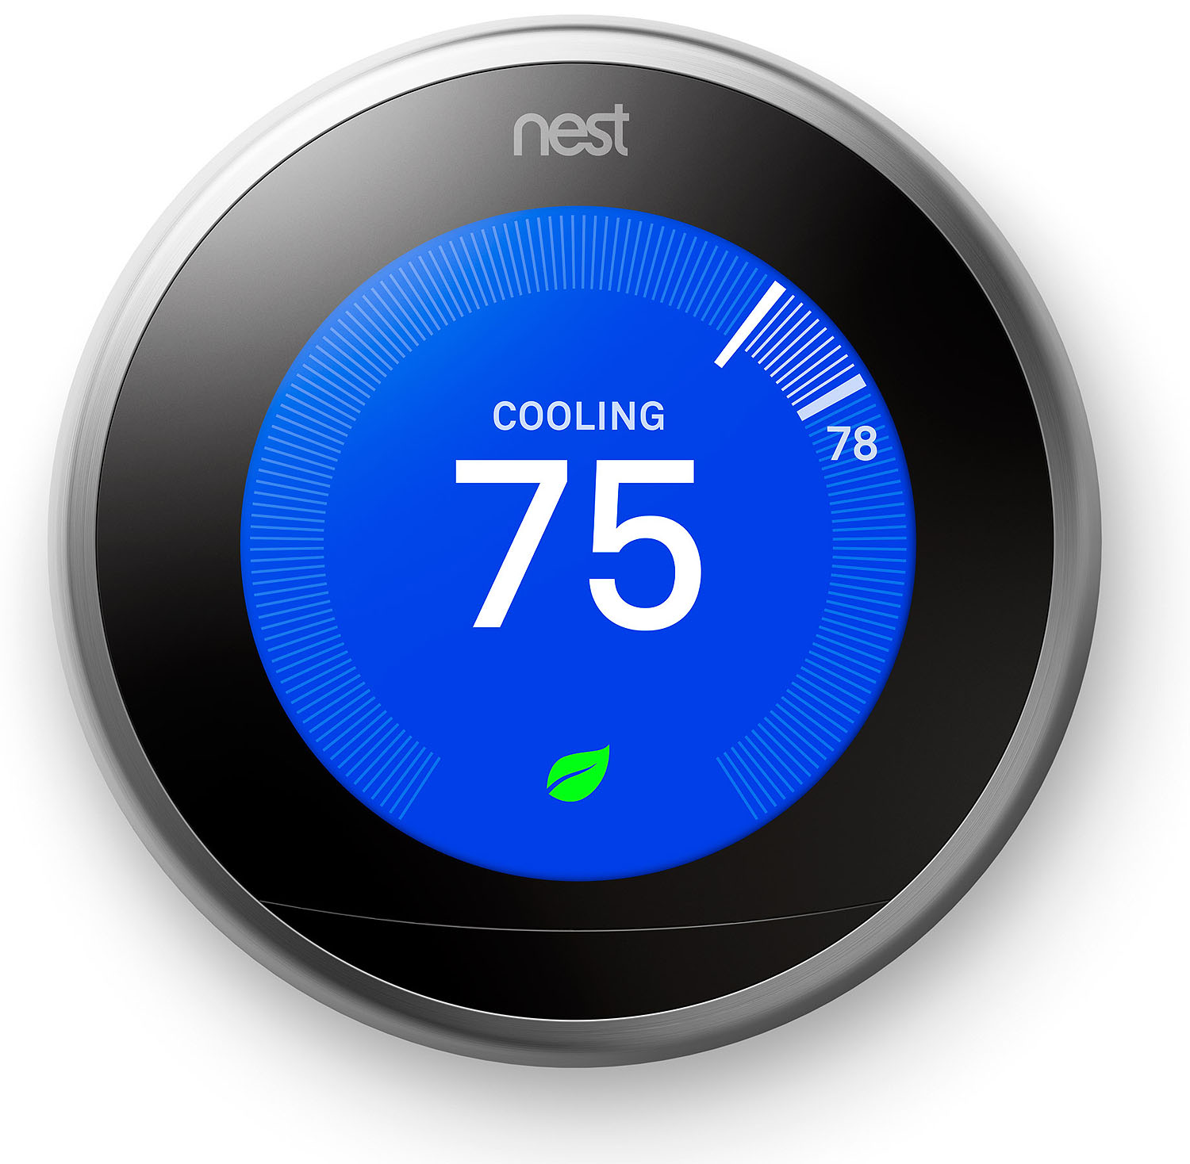
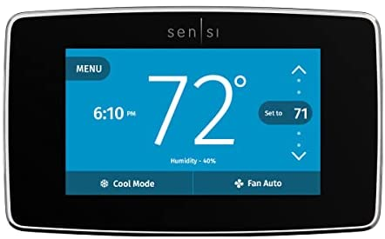
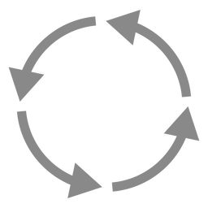
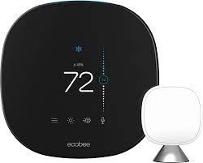
Using AMI for deeper savings in a BYOD program
November 9, 2022

Slide 2
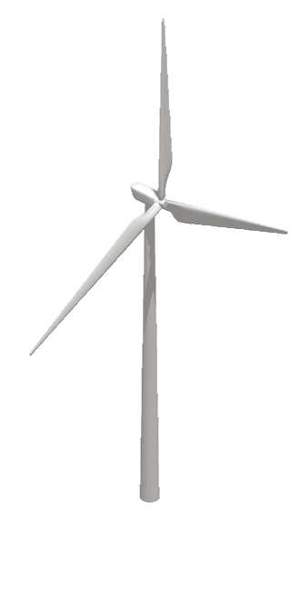
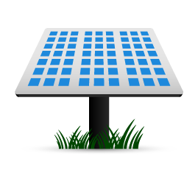
Quick Stats
~34,000 Legacy AC switches
32 Million mWh per year
984,448 electric customers
422,864 gas customers
~7,000 Thermostats
5,486 MW Summer peak

Slide 3
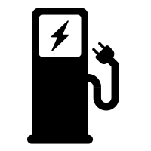
Future of Demand Response for Alliant Energy
Sunset switch program while increasing thermostat participation to replace DR potential
Reach 15,000+ thermostat participants by end of 2023
Reduce switch participation to 0 by end of 2028
Expand to call events in the winter for electric heat and/or gas heat
Self serve enrollment through an online marketplace or a BYOD sign-up
Offer multiple manufacturers with device controls
Water Heater control
Managed
charging
Two-way device control / telemetry / event data

Slide 4
Alliant Energy ® Smart Hours
Smart Hours is the residential brand for Alliant Energy’s new Demand Response programs. Essentially, a “device” control program but could expand to include future rate options such as managed TOU or charging.
Average Smart Hours Event Timeline
Pre-cooling
4-hour event
Day 1
Day 2
Event Scheduled
2-hour event

Slide 5
Demand Response Event with BYOD
Event Hours
Pre-Cooling
.9 kW – 1.1 kW per household

Slide 6
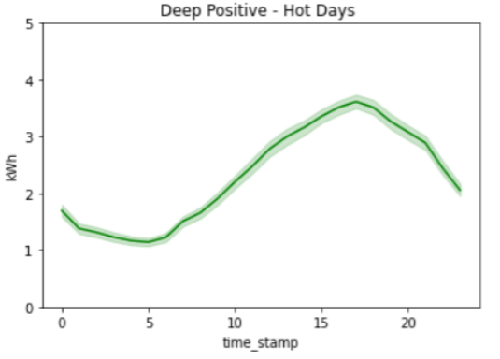
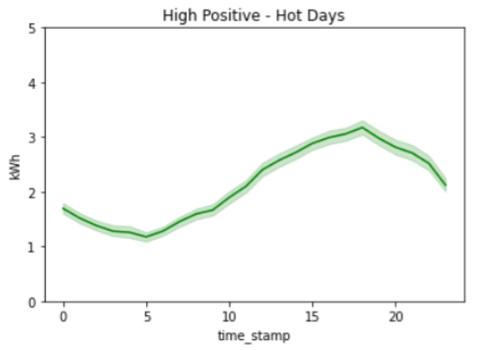
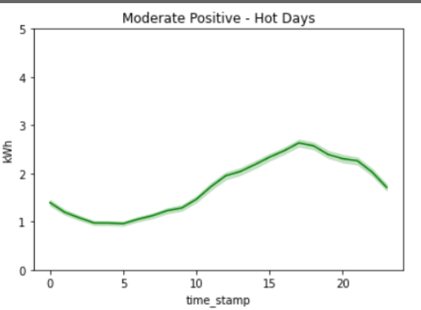
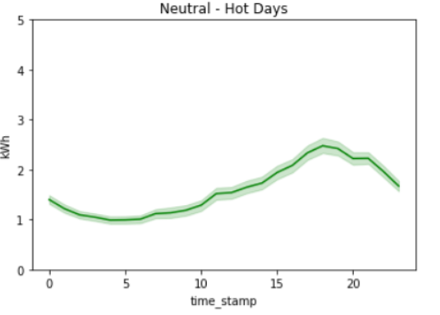
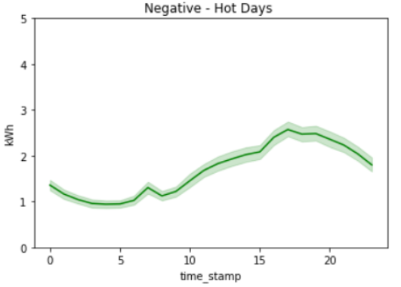
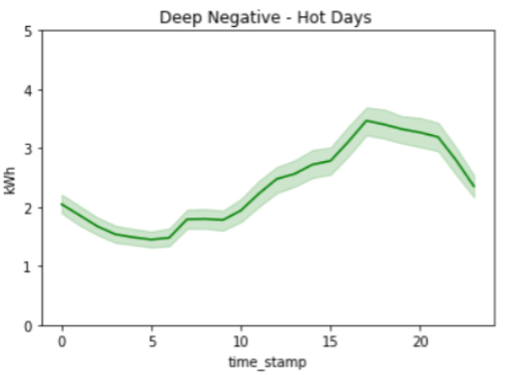
Load Shapes help identify deep savings

Slide 7
Customer Characteristics
Negative performers are more likely to care about energy costs
Load impacts are deeper and better sustained among customers with lower setpoints in the summer
Customers who are home during events are more likely to deliver deeper positive savings
Preferred setpoints are a possible key to both overrides as well as depth of savings
Overrides alone do not explain negative performance
Deeper positive performance is supported by lower incidence of overrides
Event awareness is lower among negative savers

Slide 8
How do the customers break down?
Higher energy users
Less overrides
Lower set points
Lower energy users
More overrides
Higher set points

Slide 9
Load Shapes help identify deep savings

Slide 10
Analyzing the data
Analyzed AMI data of entire residential customer base
Compared hour by hour load use for average summer load
67,680
Identified similar load shapes as high energy users in the 90th, 80th & 70th percentile

Slide 11
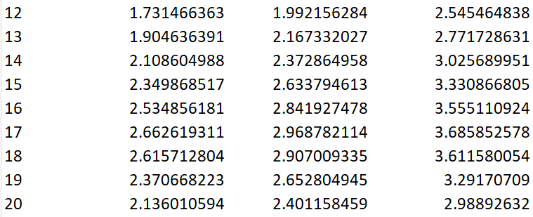
Analyzing the data
Average kW delivered per household
Hour
70%
80%
90%

Slide 12
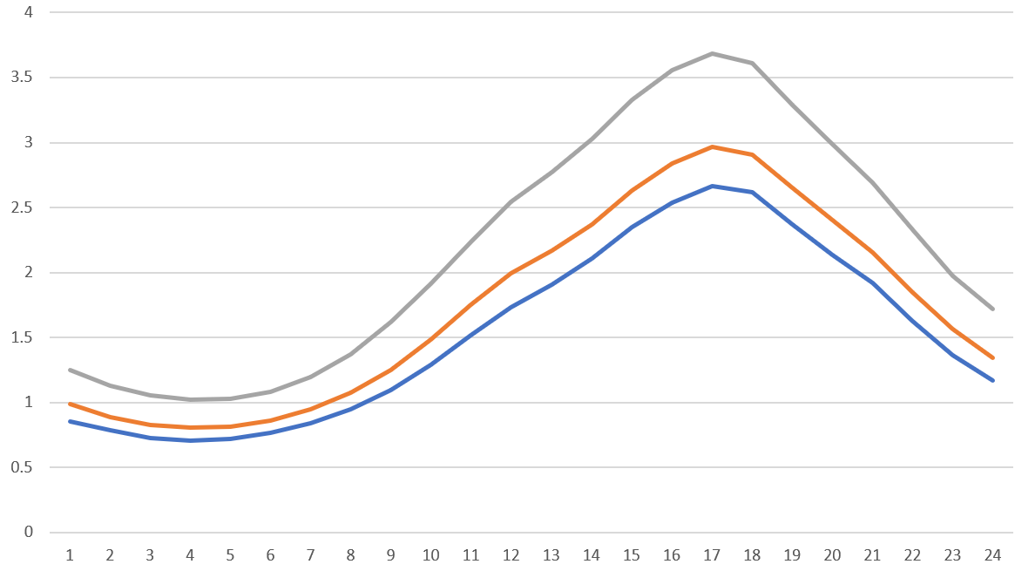
Analyzing the data
90%
Deep Saver
80%
High Saver
70%
Moderate Saver

Slide 13
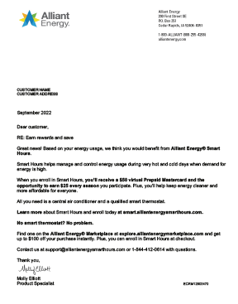
Data in action
55,612 Letters & Inserts
37,943 Email

Slide 14
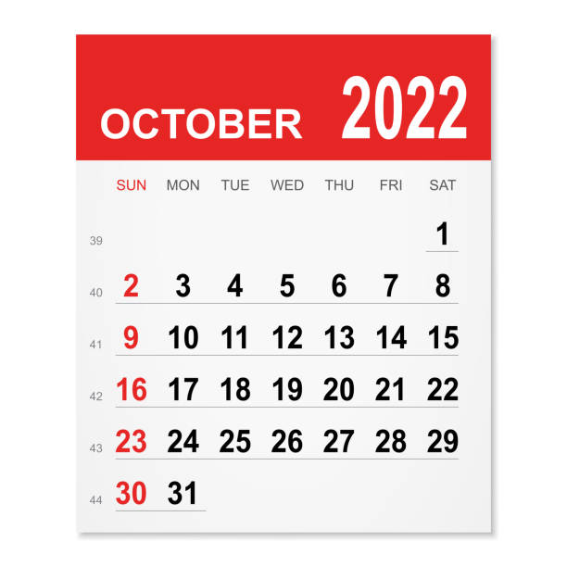
Data in action
Open Rate:
CTR:
39.5%
6.48%
181 Customers

Slide 15
Lessons Learned
Dissect and use the data
Optimize customers that provide the deeper savings
Develop personas and target customers with greater potential
Adapt to interactive customer control and develop ways to minimize opt outs
Customers have options. Discover ways to keep them engaged and delivering the savings we need

Slide 16
Questions?
Kurt Sempf
Sr. Portfolio Manager
Alliant Energy
KurtSempf@alliantenergy.com

